Slide 1
THE SPARKS FOUNDATION #GRIPMAY21
NAME: BAISHALI GHOSHAL
DATA SCIENCE AND BUSINESS ANALYTICS INTERNSHIP PROGRAM
PROJECT NAME: GIVEN THE ‘IRIS’ DATASET, PREDICTING THE OPTIMUM NUMBER OF CLUSTERS AND TRYING TO VISUALIZE THEM
TOOL USED: PYTHON LANGUAGE

Slide 2
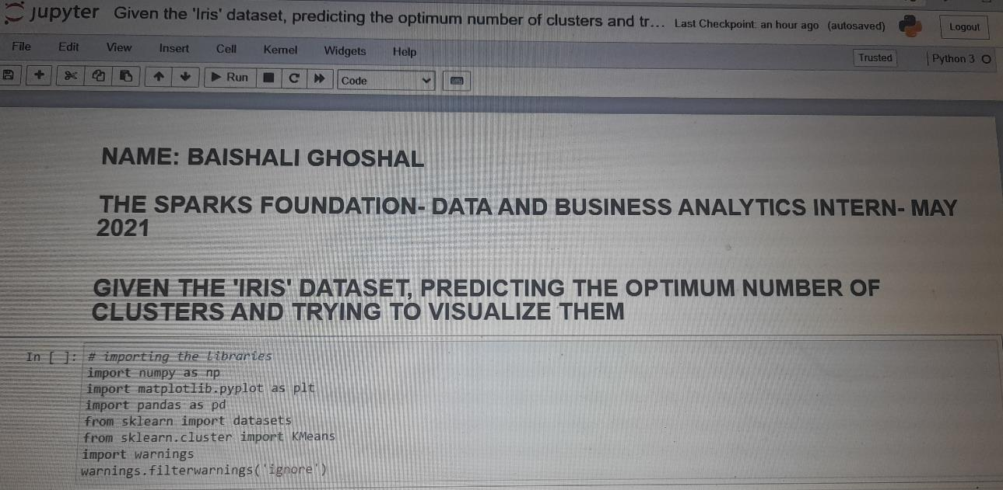

Slide 3
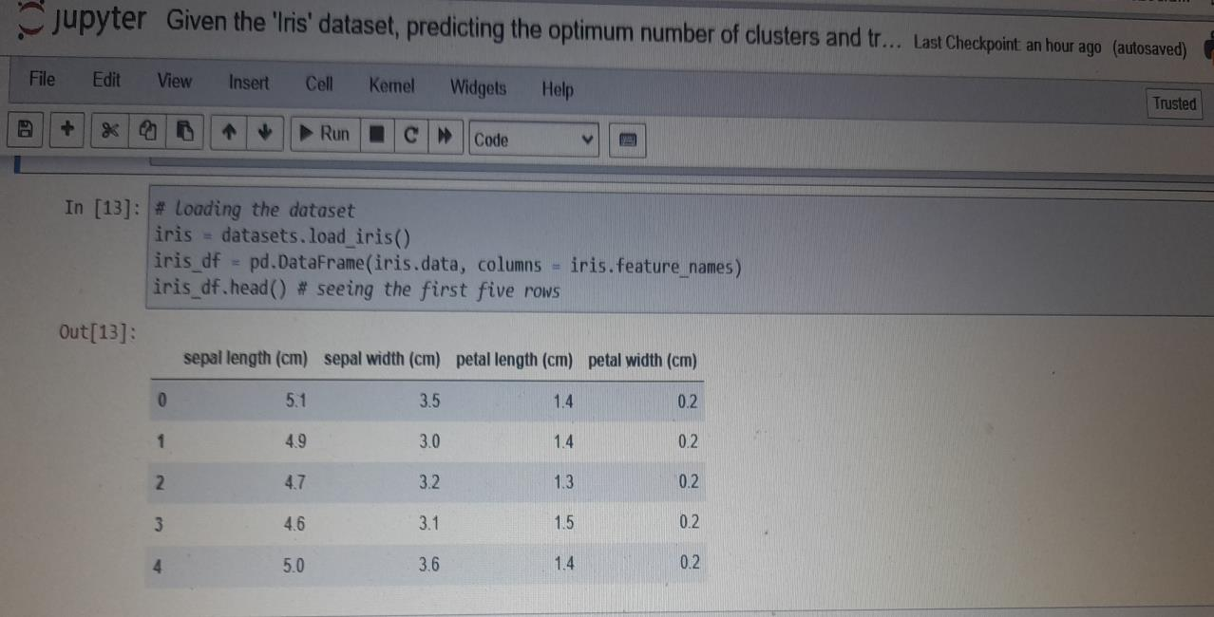

Slide 4
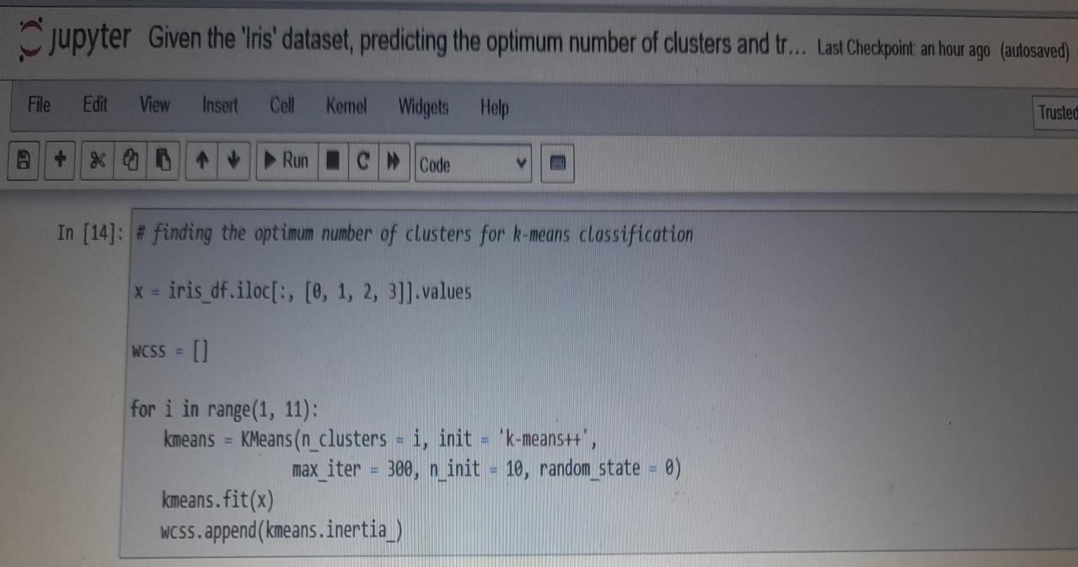

Slide 5
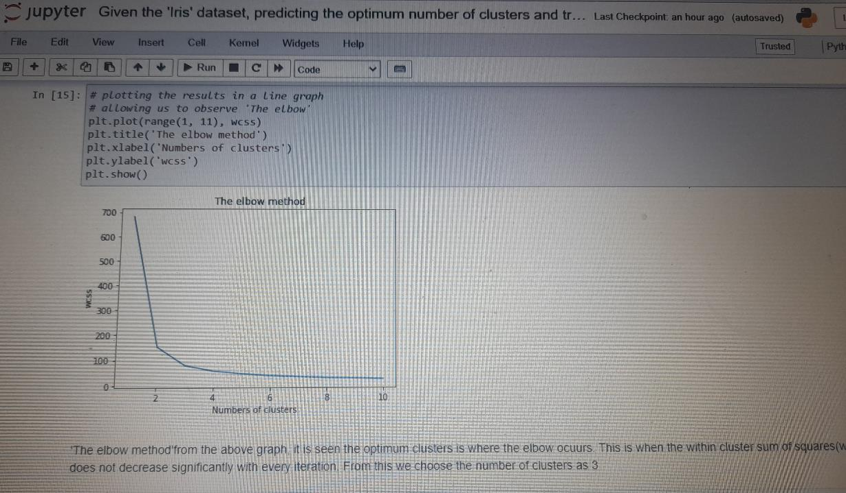

Slide 6
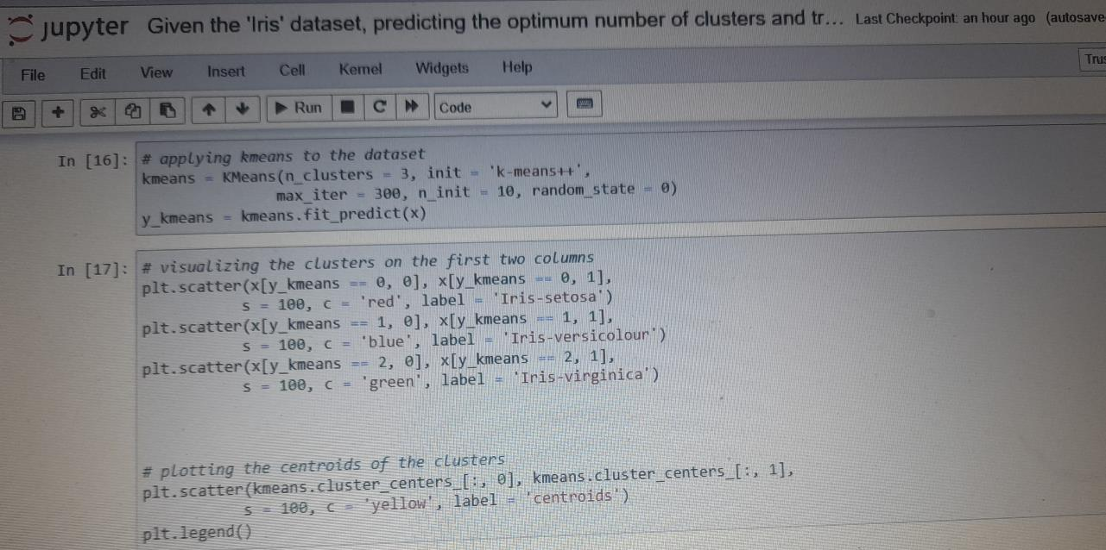

Slide 7
